Slide 1
Philanthropy Division
Viviane Kovacs, Coordinator vkovacs@hadassah.org
Ruth Ann Freedman, Vice Coordinator rafreedman@hadassah.org
https://www.dropbox.com/s/kodaqrru6jc2fzh/Peg%20Hadassah%20-%20zoom_0.mp4?dl=0
Region President’s Call – June 15, 2020

Slide 2
Presentation by Philanthropy Division in collaboration with:
Speakers Bureau – Ellyn Lyons and Lindita Bajrami
Campus Campaign Chair – Miki Schulman
Grassroots Fundraising Department – Tracey Drayer, Rosey Torres, and Max Winer
Region President’s Call – June 15, 2020

Slide 3
Top Grassroots Fundraising and Engagement Activities
Virtual Meetings: Zoom Philanthropy Speakers Tour by the Speakers Bureau
Philanthropy Speaker as core of program
Interview Style or Traditional Speaker
Philanthropy Speaker as a supplement to your program
Speaker as a complement to your primary speaker
Philanthropy Speaker as part of Region or Unit Meeting
Speaker as content information at board meeting or training
Region President’s Call – June 15, 2020
Notes:
After this slide – Presentation with Miki
Introduce idea of Presentations
Explain Presentation #1
Model Presentation #2
Introduce Miki - one sentence Bio (Chair of the Full Circle Campaign - 360 Degrees of Healing - Long history at Hadassah)
Questions for Miki:
Why is the renovation of Hadassah’s original Medical Tower, The Round Building important?
What other projects have been added recently to the Full Circle Campaign?
Will research at HMO have any connection to the new building?
Thank you for taking the time to speak with us today.
Miki make pitch (Explain Chat box - put link in Chat Box - 360 link)
Q and A with Miki in chatbox
Questions about Model #1 and #2??

Slide 4
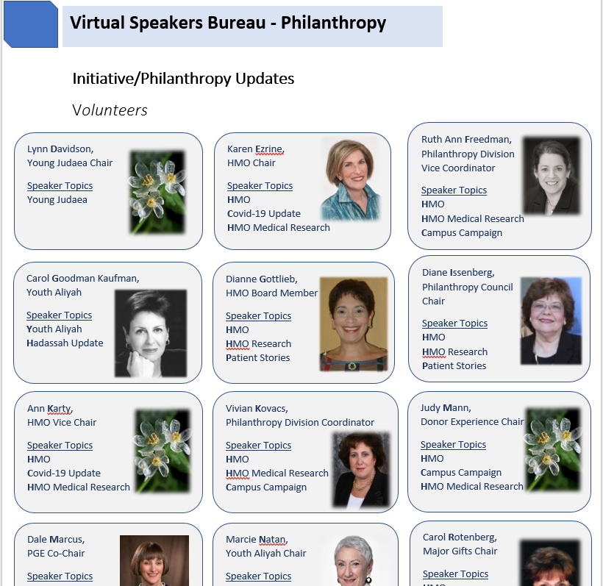
Speakers Bureau offers you:
A catalogue of virtual speakers (volunteers and staff) from the Philanthropy Division:
Presenters, Interviewers, and/or Fundraisers
Region President’s Call – June 15, 2020

Slide 5
Speakers Bureau offers you:
Speakers’ bios
Region President’s Call – June 15, 2020

Slide 6
Speakers Bureau offers you:
Interview Questions specific to each speaker (for interview-style event)
Region President’s Call – June 15, 2020

Slide 7
What Speakers Bureau needs from you:
Speaker Request Form (can be found in Presidents Library and Speakers Bureau)
Please complete the form 2 – 4 weeks in advance of event
List the type of event
Tell us what you need.. a speaker, or an interviewer, or a fundraiser? (or any combination)
Region President’s Call – June 15, 2020

Slide 8
Speakers Bureau Additional Services
Virtual speakers from all Divisions and Departments. Speaker(s) topics such as Israel, Education, Membership Engagement, and more.
Speakers from outside of Hadassah on a wide variety of topics.
If you have secured a speaker locally, the Philanthropy/Speakers Bureau can help supplement your event with an interviewer and/or fundraiser.
Revenue Share can be used to purchase Zoom License for larger group events of 100 or more. The Region license can then be shared with their chapters.
Let us know the type of event you are planning and what your goals are. We’ll be there to support you and share ideas.
Contacts:
Lindita Bajrami, Project Manager, Speakers Bureau lbajrami@hadassah.org or
Ellyn Lyons, Speakers Bureau Chair, at elyons@hadassah.org
Region President’s Call – June 15, 2020

Slide 9
Top Grassroots Fundraising and Engagement Activities
Virtual Grassroots Engagement Programs – Best ideas from YOUR units
Zoom Philanthropy Speakers Tour by the Speaker’s Bureau
Non-Event Fundraisers
Weekly Emails from National – Hadassah @ Home/H News
Region President’s Call – June 15, 2020
Notes:
Engagement Programs:
Bagels & Books OR Book & Author Luncheon/Dinner
Create a virtual Book and Author event featuring an author discussing their latest novel, memoir, autobiography, etc. During this time of physical distancing with social interaction many authors are anxious to participate in virtual events free of charge. Laugh. Drink. Get Together…for Hadassah!
Invite members, family and friends to support Hadassah by logging in for a Virtual Happy Hour featuring an entertainer. Performances by comedians, singers, musicians and poets translate well to a livestreaming platform(stage). Due to fewer concerts, clubs and venues for these performing artists to present their talents the fees charged for virtual performances are often much lower than a live event. Take a Virtual Tour of a Museum, Gallery or Historic Site
Arrange for a professionally curated virtual tour of an exciting exhibit. Members will enjoy seeing the paintings, sculptures and objets d’art and hearing the inside story of the subject and how the exhibit was created. Consider “traveling” outside your local area to virtual venues that are too far away for a typical bus trip.
Multimedia Lectures
Select a topic and you can likely find someone ready to share a PowerPoint lecture on that subject. Synagogues, libraries and community centers, etc. have long been consumers of these types of programs. Virtual presentations are likely to be less expensive than live presentations. Investigate Speakers Bureaus from across the US. Now is the time to remember the great lectures you heard about from colleagues who live in the next county or across the country. There are no travel issues for the speakers. Consider creating a lecture series and offering a subscription to increase funds raised and reduce advertising efforts. Encourage attendees to bring a friend to each session to increase the dollars raised.

Slide 10
Sharing With Units
National
Virtual Grassroots Fundraising and Engagement Strategies
A Guide for Hadassah Leaders
H News
Hadassah @ Home
Personal Share - Region Presidents to Units
Region President’s Call – June 15, 2020
Notes:
Sending an email to units

Slide 11
All Documents will be Uploaded:
Presidents’ Library
My Hadassah - Speakers Bureau
Sent in the next Presidents’ Packet, June 22nd
Region President’s Call – June 15, 2020

