Slide 1
Member & Unit Services Division
Region Presidents Monthly Conference Call
4.13.2020
https://attendee.gototraining.com/50s78/recording/4454819100731496961
Presidents’ Conference Call – 4.13.20

Slide 2
Welcome to the Presidents’ Call
We will begin shortly.
Please mute your devices.
Make sure you are in a very quiet space.
Away from TVs, pets, other noise distractions.
You get the point.
Thank you for your cooperation.
Presidents’ Conference Call – 4.13.20

Slide 3
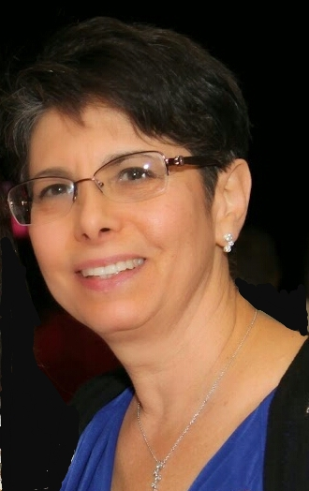
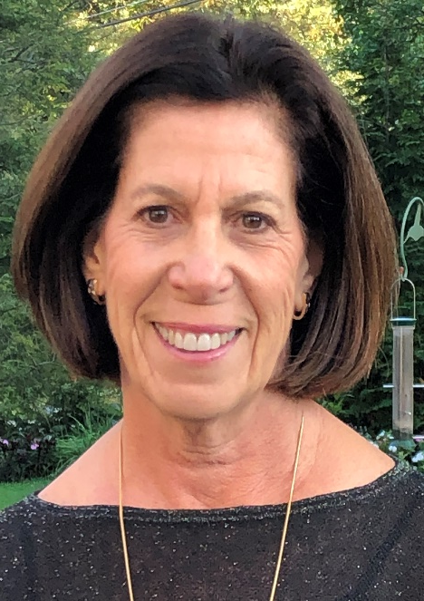
Welcome
Amy Solomon
absolomon@hadassah.org
Nancy Bluth
nbluth@hadassah.org
Presidents’ Conference Call – 3.2.2020

Slide 4
AGENDA
Welcome – Amy Solomon and Nancy Bluth
National Update – Janice Weinman
Youth Aliyah Emergency Fundraising – Marcie Natan, Carol Goodman Kaufman
Philanthropy Q&A – Viviane Kovacs, Ruth Ann Freedman
Remarks from Kacy Spivack, Member & Unit Services Division Coordinator
Announcements
Private Time
Presidents’ Conference Call – 4.13.20

Slide 5
Presidents’ Conference Call – 3.2.2020

Slide 6
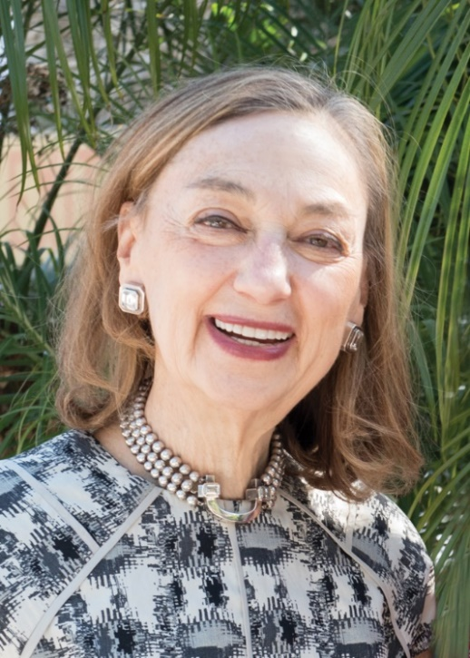
National Update
Janice Weinman
Executive Director and CEO
jweinman@hadassah.org
Presidents’ Conference Call – 4.13.20

Slide 7
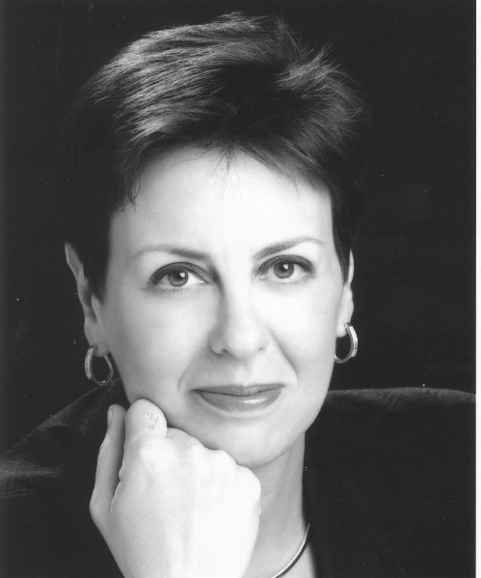
Youth Aliyah: Emergency Fundraising
Marcie Natan
Youth Aliyah Chair
mnatan@hadassah.org
Carol Goodman Kaufman
ckaufman@hadassah.org
Presidents’ Conference Call – 4.13.20

Slide 8
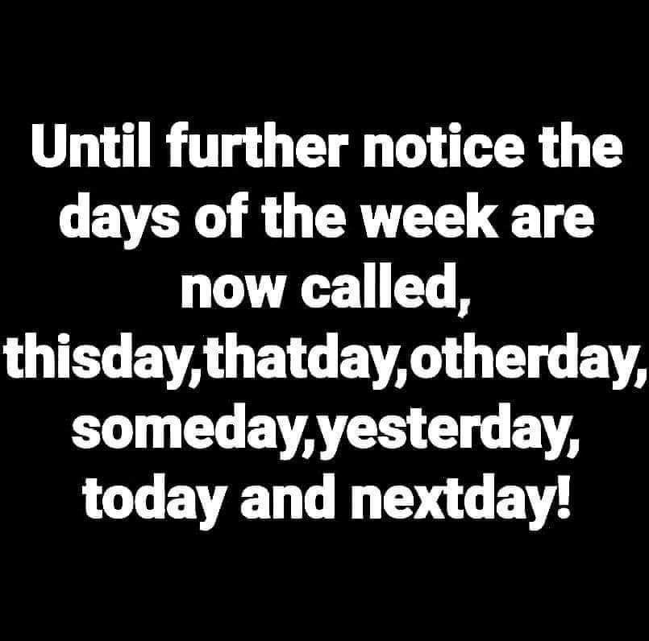

Slide 9
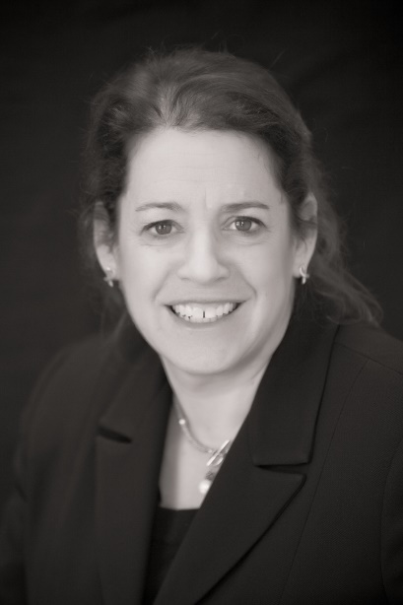
Philanthropy Division
Viviane Kovacs
Coordinator
vkovacs@hadassh.org
Ruth Ann Freedman
Vice Coordinator
rafreedman@hadassah.org
Presidents’ Conference Call – 4.13.20

Slide 10
TOP ENGAGEMENT & GRASSROOTS FUNDRAISING STRATEGIES DURING SOCIAL DISTANCING: A Guide to Hadassah Leaders
Region Driven Support
ICU Bed Fundraiser
Virtual Events with Zoom
Non-Event Fundraisers (No Show Events)
Presidents’ Conference Call – 4.13.20
Notes:
Thank the Region Presidents for supporting COVID 19 fundraising. Thank - Michelle and Greta, Barbara and Barbara
Respond to Region Presidents about “Why we need to fundraise?”

Slide 11
Update on COVID 19 – OPERATIONS
Donor Services Process
Daily Calls are being answered
24 hour turn-around
Fundraising and Membership Service
Credit By Region
HMOCOVID
YACOVID
MERKLE Processing
Merkle is approximately 3 weeks behind due to staffing issue
Focused on high level donor transactions
FACEBOOK Credit
Presidents’ Conference Call – 4.13.20
Notes:
Operations will complete
Facebook – 1-2 month lag for credit to accounts

Slide 12
During/Post COVID Fundraising
Funds Raised to Date:
Regardless of what is happening around the world, even during the Pandemic, HMO still has obligations and we as HWZOA have a responsibility to support them.
Needs are actually greater.
Presidents’ Conference Call – 4.13.20
Notes:
Needs are greater – less patient occupancy, NO payments from PA, no medical tourism
Mount Scopus in 1930’s
Do the best you can, given the circumstances.

Slide 13
Major Gifts Parlor Meetings Expenses Coverage
Shared Expense
Work with Major Gifts Officer
Grateful Patients
National pays for Travel and Hotel Expenses (Speaker)
Presidents’ Conference Call – 4.13.20

Slide 14
GAAP Goals Vs Actual
Bequest Data is now on Clearview as of February 29^{th.}
GAAP Goals for 2020 discussion
Presidents’ Conference Call – 4.13.20
Notes:
GAAP Goals for 2020 will be re-evaluated in an ongoing manner as the Pandemic plays out.
All COVID $$ will be credited toward GAAP goals

Slide 15
FINDING THE CURE FOR COVID 19 Hadassah Researchers Leading the Way:
Prof Allon Moses seeks to explore the question of the use of Hydroxychloroquine in the prevention of the coronavirus infection in people at high risk following exposure to the virus.
Prof. Nir-Paz seeks to examine the efficacy of adding Favipiravir to Hydroxychloroquine in reducing the viral shedding of the disease.
Presidents’ Conference Call – 4.13.20
Notes:
The world is facing a pandemic of proportions unseen by humankind in a century. In December 2019, a novel pneumonia caused by a previously unknown pathogen emerged in Wuhan, China. The pathogen was soon identified as a novel coronavirus (COVID-19), which is closely related to severe acute respiratory syndrome CoV (SARS-CoV). The virus causes primarily lung injury, along a continuum of increasing severity from acute lung injury (ALI) to acute respiratory distress syndrome (ARDS). COVID-19 poses a major public health threat to civilization. It is sweeping across the globe and leaving tens of thousands of deaths in its wake. Currently, there is no specific treatment against the new virus. Therefore, identifying effective agents, to combat the acute forms of disease, are urgently needed. Hadassah doctors today are laboring to find ways of treating and preventing the disease through the following research projects
Hydroxychloroquine, a less toxic derivative of the antimalarial chloroquine, has been recently shown to be effective in inhibiting COVID-19 infection in vitro and has been used successfully to treat 80 patients. There is a great need for a well-designed study to answer the question of this drug's efficacy against SARS-CoV-2.

Slide 16
Other Research – See Talking Points
Hadassah to Launch Clinical Trials of a Serum to Fight COVID-19 (April 8th)
Hadassah to Initiate Trials of Japanese Drug to Fight COVID-19 (April 7th)
Presidents’ Conference Call – 4.13.20

Slide 17
July President’s Training Pre-Assessment
 | Never heard of the concept/tool | Heard of the concept/tool, but never used | Heard of the concept/tool and used with limited success | Heard of the concept/tool and used successfully
Grassroots Giving
Annual Giving
Major Gifts
Planned Giving
360° of Healing Campaign
Elevator Pitch
Unrestricted Giving
Donor Cycle
Identified a donor for a gift
Cultivated a donor for a gift
Asked a donor for a gift
Presidents’ Conference Call – 4.13.20

Slide 18
Questions and Concerns
Presidents’ Conference Call – 4.13.20

Slide 19
Remarks from Kacy Spivack
Kacy Spivack
Member & Unit Services Division Coordinator
kspivack@hadassah.org
Presidents’ Conference Call – 4.13.20

Slide 20
Welcome! Lisa Davidson Organization Division Coordinator ldavidson@hadassah.org
Presidents’ Conference Call – 4.13.20

Slide 21
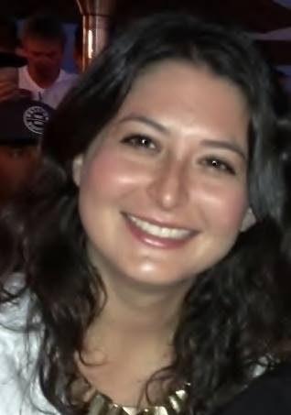
Congratulations! Lindy Ettin Organization Division Director
Presidents’ Conference Call – 4.13.20

Slide 23
Announcements
Presidents’ Conference Call – 4.13.20

