Slide 1
Member & Unit Services Division
Region Presidents Monthly Conference Call
2.10.2020
https://attendee.gototraining.com/50s78/recording/7838110936298804993
Presidents’ Conference Call – 2.10.2020

Slide 2
Welcome to the Presidents’ Call
We will begin shortly.
Please mute your devices.
Make sure you are in a very quiet space.
Away from TVs, pets, other noise distractions.
You get the point.
Thank you for your cooperation.
Presidents’ Conference Call – 2.10.20

Slide 3
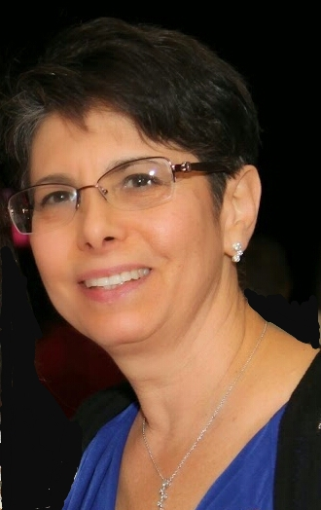
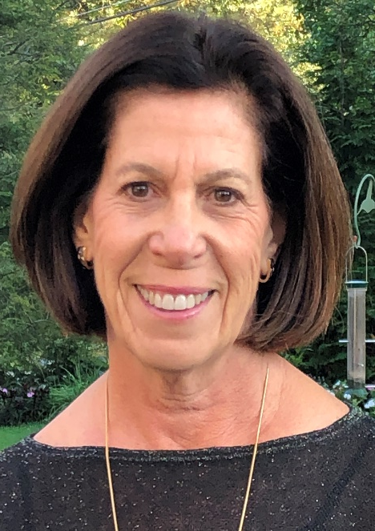
Welcome
Amy Solomon
absolomon@hadassah.org
Nancy Bluth
nbluth@hadassah.org
Presidents’ Conference Call – 2.10.2020

Slide 4
AGENDA
Welcome – Amy Solomon, Nancy Bluth
National Update – Rhoda Smolow
PRAZE Division – Judy Shereck
Guide to Election Year and Political Activities
WZO Elections
Membership – Luisa Narins
Heart Health Month Activity
Marketing & Communications Division – Fran Feldman and Patricia Levinson
Enhancing Local Marketing, Communications and PR
Private Time with Amy and Nancy
Presidents’ Conference Call – 2.10.2020

Slide 5
National Update
Rhoda Smolow
National President
rsmolow@hadassah.org
Presidents’ Conference Call – 2.10.2020

Slide 6
PRAZE Division
Guide to Election Year and Political Activities
WZO Elections
Judy Shereck
Coordinator
jshereck@hadassah.org
Presidents’ Conference Call – 2.10.2020

Slide 7
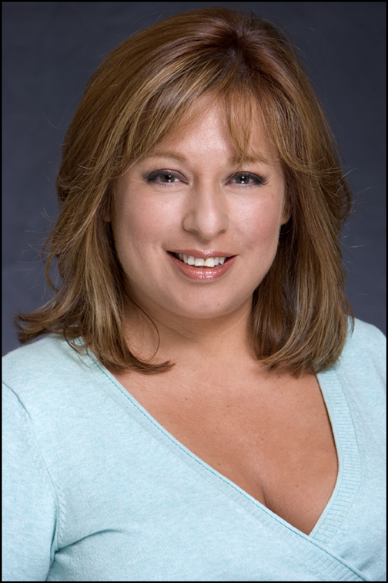
Membership Department
Activity of the Month
Hearth Health Awareness
Luisa Narins
Membership Department Vice-Chair
lnarins@hadassah.org
Presidents’ Conference Call – 2.10.2020

Slide 9
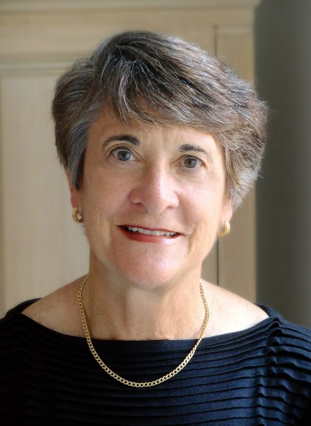
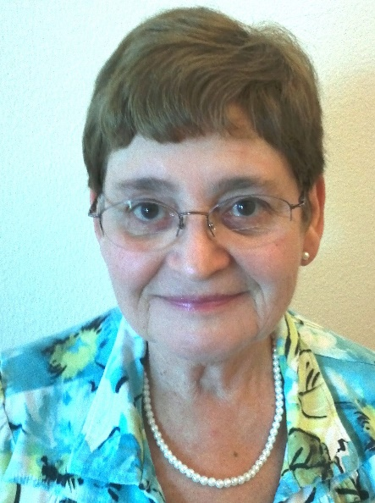
Marketing & Communications Division
Fran Feldman Patricia Levinson
Co-Coordinator Co-Coordinator
ffeldman@hadassah.org plevinson@hadassah.org
Presidents’ Conference Call – 2.10.20

Slide 10
Marketing & Communications Division
Enhancing Hadassah’s Local Marketing,
Communications and Public Relations
Presidents’ Conference Call – 2.10.20

Slide 11
Marketing & Communications Division
PAINTING A PICTURE OF CURRENT LOCAL COMMUNICATIONS
WE DID AN ANALYSIS OF THE PIF DATA WITH REGARD TO:
Bulletin Editors
Social Media Chairs
M&C/PR Chairs
Presidents’ Conference Call – 2.10.20

Slide 12
Marketing & Communications Division
ANALYSIS SHOWS THAT:
Most active chapters have their own bulletin.
Often, there are several regions and chapters within a close geographic area that each have individual M&C/PR Chairs even though they share the same media outlets.
A large number of Social Media Chairs are scattered across the country.
Presidents’ Conference Call – 2.10.20

Slide 13
Marketing & Communications Division
WHAT NATIONAL CAN DO FOR YOU
We will be in periodic communication with each group of portfolio holders.
For bulletins we can provide the following:
A branded bulletin template
An inspiring Hadassah story each month
A “What's new in Hadassah” each month
We can provide Social Media training.
We can provide PR training (see current Leader’s Digest).
Presidents’ Conference Call – 2.10.20

Slide 14
Marketing & Communications Division
WHAT YOU NEED TO DO
Areas using the same media outlets can form M&C teams with a representative from active units to maximize impact.
Mid/far flung regions need a local M&C/PR volunteer in major cities.
Consider having a social media page.
Bring M&C training to your local conferences and meetings.
Presidents’ Conference Call – 2.10.20

Slide 15
Marketing & Communications Division
REMEMBER
ALL NEWS IS LOCAL
There is more to local news than meeting announcements.
We can teach you how to make Hadassah news local.
Ads are fleeting and very expensive.
Stories are remembered and repeated.
THE POWER TO HEAL OUR WORLD IS IN OUR HANDS.
BY WORKING TOGETHER, WE CAN INSPIRE OTHERS.
TOGETHER, WE CAN ENHANCE HADASSAH’S IMAGE.
Presidents’ Conference Call – 2.10.20

Slide 16
THANK YOU
Fran Feldman Co-Coordinator Marketing and Communications ffeldman@Hadassah.org 617-968-1204 Patricia Levinson Co-Coordinator Marketing and Communications plevinson@Hadassah.org 727-437-9946 | Eleanor Goldhar Division Director Marketing and Communications egoldhar@Hadassah.org 212-303-8140 Sheryl Hoffman Director of Marketing and Special Projects shoffman@Hadassah.org 212-303-8120
Presidents’ Conference Call – 2.10.20

Slide 17
Presidents’ Conference Call – 2.10.20

