Slide 1
HOW TO BE A GOOD PAST·PRESIDENT & WHAT COMES NEXT

Slide 2
The PERFECT Past President
Passion for the Hadassah Mission
Experience and Leadership
Ruach (spirit)and love for Israel
Finesse and fearlessness
Energy and organization
Caring and creativity
Tenacity
Region Presidents’ Training – July 12, 2020
Notes:
Perfect

Slide 3
Support
Advice
Assistance
Remember how you felt coming in three years ago! What did your predecessor
do or not do?
Tips
Help
Guidance
Notes:
Resource Chairs, classmates and former Region presidents are wonderful assets.
Remember to let go, it’s time to move on. You can be the elder statesman now.

Slide 4
EXPECTATIONS:
Monthly ZOOMs
Presidents’ Trainings
National Assembly Meetings
Notes:
President’s calls: how to raise hand. Use of chat box. When to find the recordings.
A general overview of president’s training.
What to expect at National Assembly meetings.

Slide 5
START INCLUDING
YOUR SUCCESSOR
NOW!
Notes:
1. Work together to formulate the annual plan.
2. Keep her informed when you have problems and how you solve them.
3. Show her how the region operates.

Slide 6
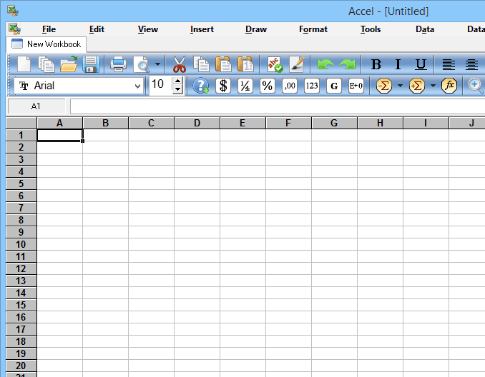
KEEP HER
IN THE LOOP
(National and Region)
ESPECIALLY
ANNUAL PLAN
Notes:
Explain monthly president’s calls, what to expect, length of call.
Tell her about the PRC and National board representatives.
Stress the importance of registering for calls for training and National Assembly.
Explain the importance of attendance at both National Assembly meetings. They are there to attend all sessions.

Slide 7
Don’t be a
“mother-in-law."
Be there to advise and support without telling her what to do.
Notes:
Be a mentor, groom her.
Tell her to complain up, NOT to her board.
Be supportive to her ideas, not say, “I did it this way”
Explain the importance of establishing a good working relationship with professional staff members.

Slide 8
Stay back during
Region meetings
unless specifically
asked a question
Notes:
Try to sit back and blend into the furniture.

Slide 9
IMPORTANCE OF:
Resource Chairs
Trainers
Classmates
Veteran Presidents
Staff
Notes:
These are your “Go To” people

Slide 10
Transition may be difficult.
Seek classmates and
Past region presidents
for support.

Slide 11
Encourage other
board members to be
there for her as
they were for you.
Notes:
Encourage the board and members not to come to you with questions or problems.
Do not entertain negative remarks about your successor.

Slide 12
A Perfect Past President is like a good bra…
…Hard to find
…Supportive, mentoring and modeling best practices
…Uplifting with a positive attitude
…Never lets you down or leaves you hanging
…Comfortable with roles and situations
…In-style, understands the region culture
…Seamless, transferring and transitioning leadership
…Reliable, there when needed; always comes through
…Unobtrusive, effective behind the scenes
ALWAYS CLOSE TO YOUR HEART
Notes:
We will be very excited to hear about your new roles. Please share your successes with us!

Slide 13
WHAT COMES NEXT
AT NATIONAL ?
Exit Interviews
National Assembly Member responsibilities
(when you’re not a Region President)

