Slide 1
Unit Profiles
Planning Strategically for 2021
August 10, 2020
https://us04web.zoom.us/rec/share/pvNuAbP7rEpIQpWO8XDiRvIAD7j6X6a81iNI-qAIzxtGhCuwNELnr_fCK49MMiPy?startTime=1597104163000
Notes:
Sally Welcome

Slide 2
Annual Planning Resources
2019 Region Annual Plan and Evaluation
2019 Unit Health Survey
2017 - 2019 Region Unit Profile
National Priorities, Programs, Initiatives
Annual Planner, Resource Chair, Managing Director
Organization Division
Notes:
Lindy to walk through Resources

Slide 3
2020 Annual Plan

Slide 4
Unit Health Survey: Membership, Fundraising, Leadership
Notes:
Lindy

Slide 5
Unit Profiles
Notes:
Lindy

Slide 6
What is a Unit Profile?
Summary of income, expenses and overall health of the Region
Provides perspective on how your Region is performing
Portrays Hadassah’s overall performance and the “bigger picture”
Gives you “thought starters” on how to interpret the data
Data is purely analytical – this is not a critique of the Region
Shows trends for the past 3 years
Helps you make better business decisions
Notes:
Sally

Slide 7
What do you do with the Unit Profile?
Determine the needs of your Region
Create strategies for how to address these needs
Identify the tactics i.e. programs and activities that make up each strategy
Decide where your efforts and resources will achieve the most ROI
Identify units from the unit health survey (green, blue, yellow, etc.)
Notes:
Sally

Slide 8
From Unit Profile
To Annual Plan
NARRATIVE
LOCATION
TACTICS
STRATEGIES
GOALS
UNIT PROFILE
AP
S.M.A.R.T
Evaluate
Where
Red
Yellow
Green
Blue
Purple
How
Activities
Events
National Priorities
Programs
Enhance Leadership Training
What
Attract Younger Women
Identify New Coalition Partners
Create Engagement Opportunities
Membership
Fundraising
Education
Programming
Engagement
Leadership
Trends
Thought Starters
Perspective
Analysis
Data
Performance
Bigger Picture
Notes:
Lindy

Slide 9
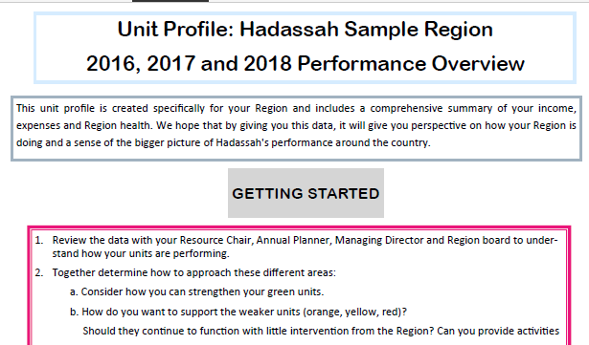
2017, 2018, 2019 Unit Profile: Performance Overview
2017, 2018, 2019
Notes:
Sally

Slide 10
Who You Gonna Call?
Annual Planner
Resource Chair
Managing Director
Sally Kleinman – skleinman@hadassah.org
Lindy Ettin – lettin@hadassah.org

Slide 11
Still With Us? If you would like to set up one-on-one conversations to review your profile, please contact Sally or Lindy (skleinman@hadassah.org & lettin@hadassah.org)

Slide 12
Revenue Share

Slide 13
Basics You Need to Know
National gives Regions operating funds
All fundraising sent to National to support our work in Israel
Donors receive FULL credit
Allocations based on:
2017 UNRESTRICTED Grassroots
2017 Major Gifts Fundraising
2017 Membership performance
Needs based model

Slide 14
Allowable Revenue Share Expenses: Regions
Travel to units by Presidents and Area Advisors
Conferences/Meetings/Trainings:
Travel for members of the Region Boards
Includes hotel rooms (double occupancy) for members of the Region Boards
Participants should be paying a reasonable couvert to cover some of the expenses
Speakers
Administrative expenses in approved offices
Subvention of members to Conferences & Convention
Those subvented should be required to follow guidelines set by Presidents
Discretionary funds for Presidents use
Attendance at community or coalition partner events that include Hadassah in the program or on the agenda

Slide 15
Allowable Revenue Share Expenses: Chapter/Group
Chapter/Group Board Meetings/Trainings/Events
In consultation with Region leadership, subvent members to Conferences/Convention
In order to receive Revenue Share Chapters/Groups can:
Submit an annual plan/operating budget
Bank statement
Have a meeting or conference call with the Region President/Treasurer
If the Chapter/Group is not requesting Revenue Share, why?
Do they have a bank account?
Are they fully self sustaining?
Are they using fundraising money to cover their expenses?

Slide 16
FUNDRAISING EVENTS SHOULD MAKE A PROFIT WHILE COVERING ALL COSTS
MEMBERSHIP, PROGRAMMING, LEADERSHIP & EDUCATIONAL EVENTS SHOULD INCORPORATE A FUNDRAISING COMPONENT & ATTEMPT TO BE
SELF-SUSTAINING
Notes:
Lynn

Slide 17
Annual Plan
Notes:
Sandy

Slide 18
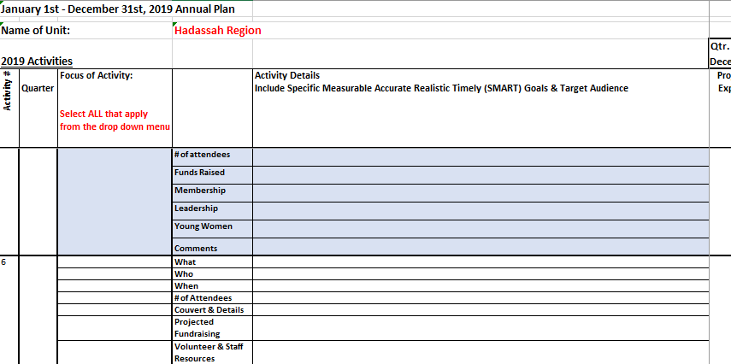
Annual Plan Form

Slide 19
Key Partners in the Annual Planning Process
Executive Board
Treasurer
Annual Planner and Resource Chair
Managing Director of Consolidated Area
Past Presidents
Up and coming potential leaders
New Members

Slide 20
Respond to Changes & Challenges
Identify challenges in meeting Annual Plan Goals
Brainstorm ways to respond to the challenges
Executive Board selects response strategy
Implement response strategy/strategies
Incorporate strategy into the Annual Plan
Notes:
Sandy

Slide 21
Develop Board Leadership
Prepare Hadassah for transition for meeting new challenges
Set the vision
Plan for the future
Evaluate and decide where and when to spend time, money, volunteer resources and staff resources
Notes:
Sandy

Slide 22
They always say time changes things, but you actually have to change them yourself. -- Andy Warhol
Luisa Ellenbogen
lellenbogen@hadassah.org
Notes:
Sandy

Slide 23
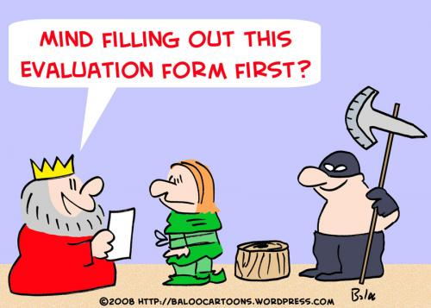
Evaluation
Notes:
Lynn

Slide 24
Evaluation
Mandatory to complete
This is a roadmap to use throughout the year – not just at the end.
Should include details about event/activity
The more specific your activity description, the easier it will be to evaluate
Results of SMART Goals
WHY?

Slide 25
Questions?

Slide 26
